Slide 1
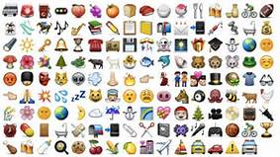
FAQs/Samples
Emoji project

Slide 2
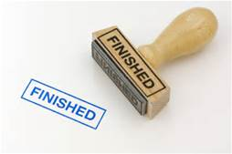
Q. What exactly does a finished project look like?
Examine the next two slides for excerpts of student reviews. Then, the slide after those includes a screenshot of a full review, just to give you an idea.

Slide 3
Excerpt from a project on The Help—Note that the student includes the translation of the emoji right in the piece, which is fine!

Slide 4
Excerpt from a project on The Catcher in the Rye -This student submitted another, separate review with the words written above the images, which was also fine.

Slide 5
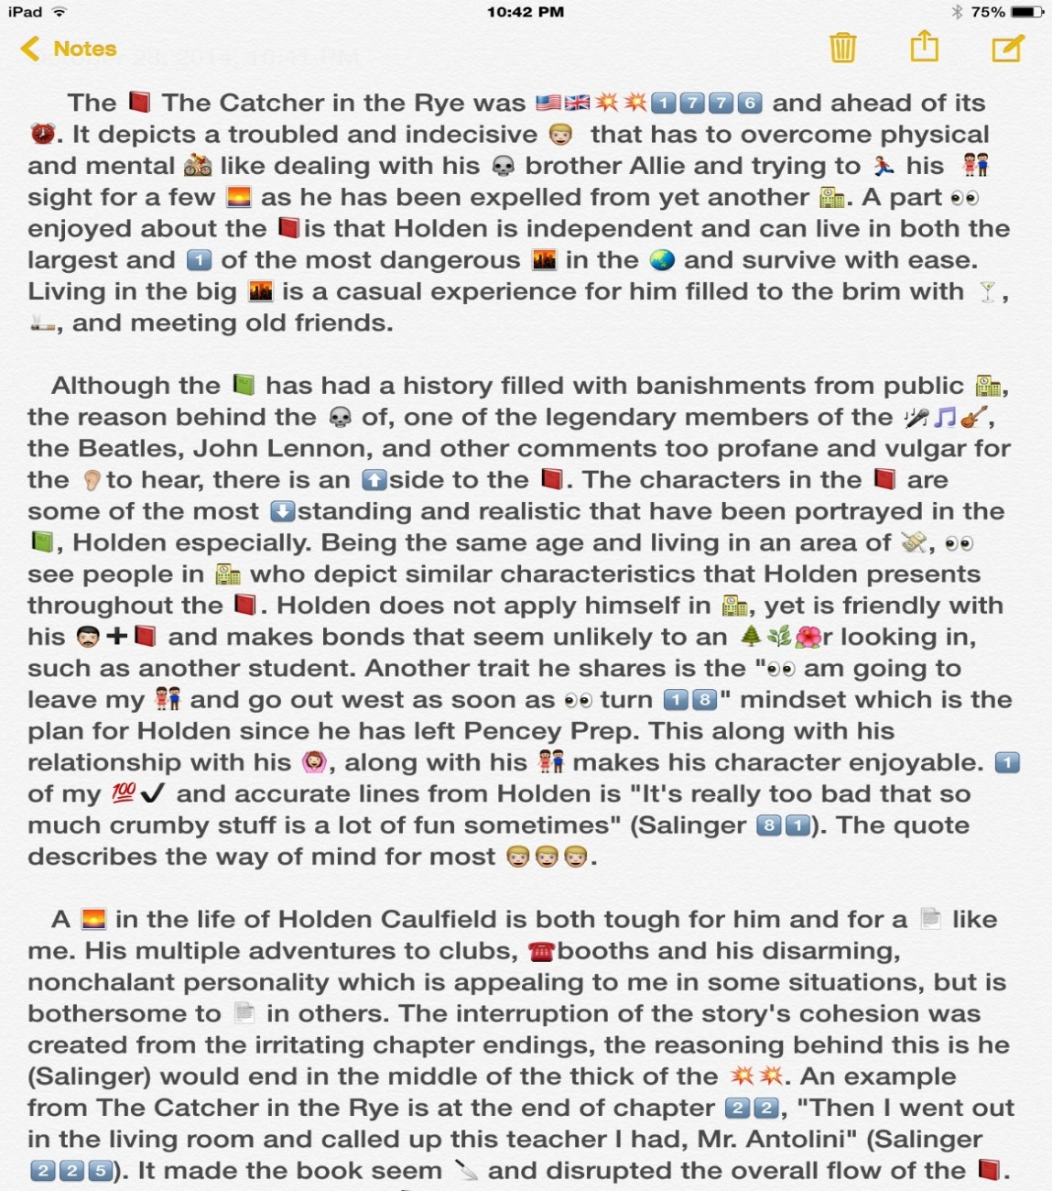
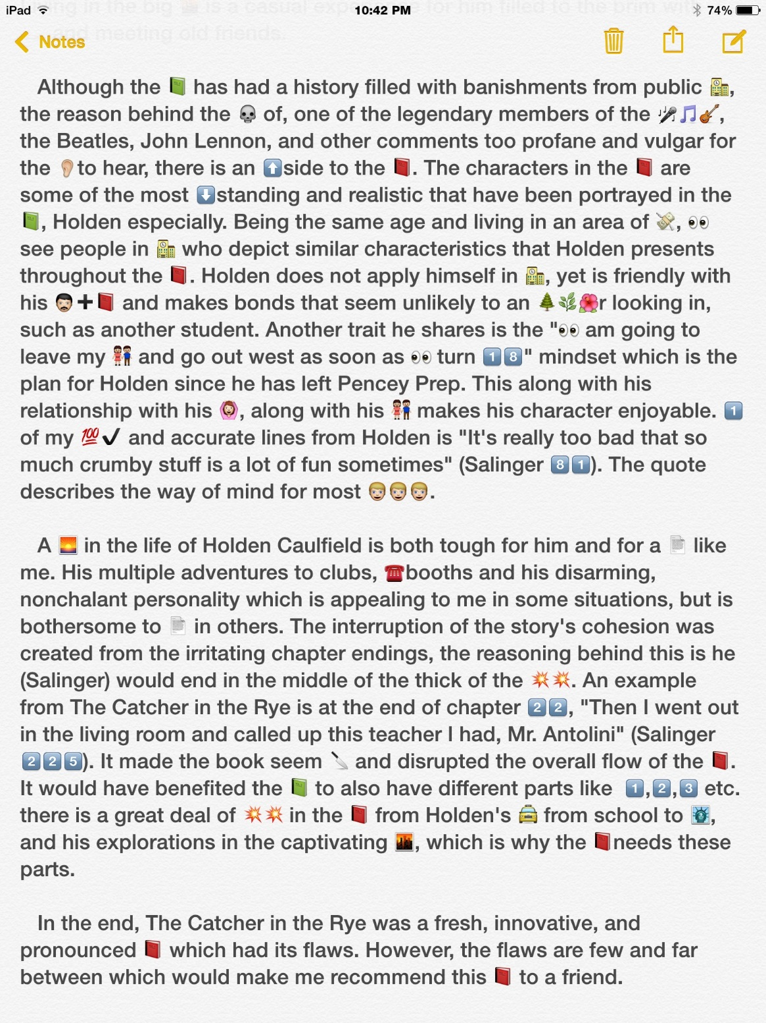
STUDENT SAMPLE – This is a thorough review! ☺

Slide 6
What kinds of things do I write about as I craft a review?
Remember the ideas on the actual instruction sheet. Think not only about what you liked/disliked, but about what made your book of literary merit (or not).

Slide 7
CONTINUED
What kinds of things do I write about as I craft a review?

Slide 8
Q. What does the teacher want with annotations on our new emojis?
Check out the sample below that has a new emoji to represent part of the book’s title for a project on The Book Thief. You can include them at the end of your review.

Slide 9
Q. What does the teacher mean that we are supposed to annotate our review for the components?

